Slide 1

Braitenberg’s Vehicles and Cybernetic Robotics
Steve Battle,
Bristol Robotics Lab, UWE

Slide 2
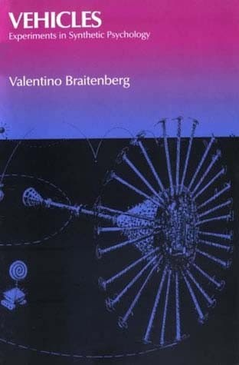
Vehicles Experiments in Synthetic Psychology by Valentino Braitenberg (1984)
“Get used to a way of thinking in which the hardware of the realization of an idea is much less important than the idea itself. Norbert Wiener was emphatic about this when he formulated the title of his famous book: Cybernetics, or Control and Communication in Animals and Machines.” – Braitenberg
Notes:
See also Marken & Powers “Random-walk chemotaxis” of E. Coli in ‘Mind Readings’.

Slide 3
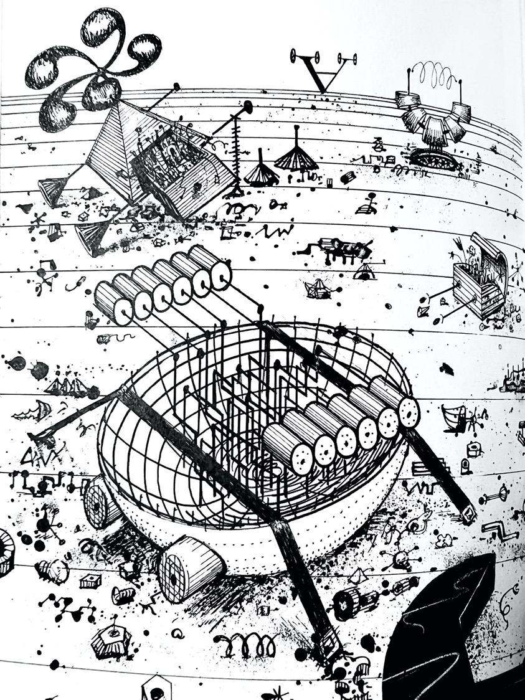
Vehicles of Thought
“This is an exercise in fictional science, or science fiction, if you like that better. Not for amusement: science fiction in the service of science.” – Braitenberg

Slide 4
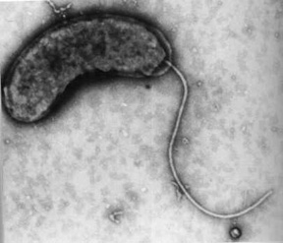
Nature’s Vehicles: E Coli
The flagellum is a long hollow filament
At the base, a flagellar motor rotates at 100 revolutions per second.
The direction of rotation determines the kind of movement.

Slide 5
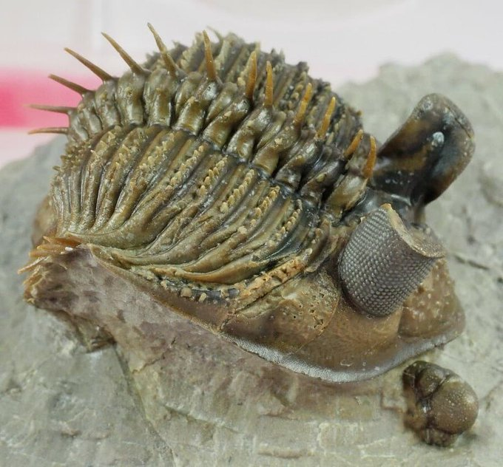
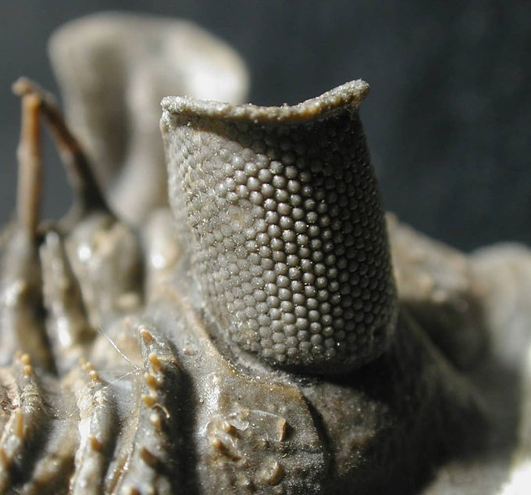
This trilobite is called Erbenochile. It had incredibly tall, tower-like eyes that provided 360-degree vision!
Fortey and Chatterton. 2003. A Devonian Trilobite with an Eyeshade. Science.
Notes:
https://twitter.com/Dean_R_Lomax/status/1417501261423906816

Slide 6

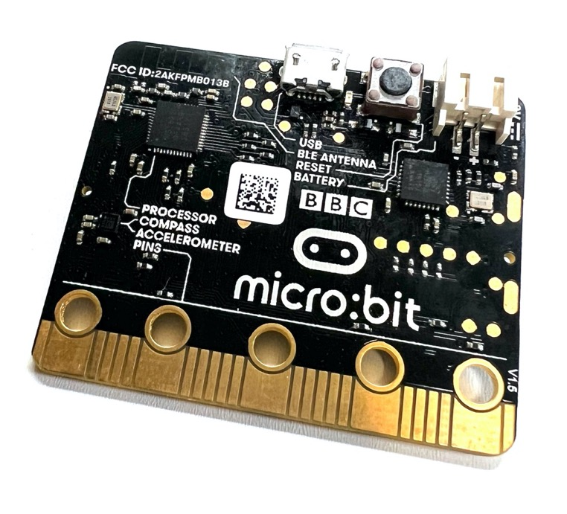
Connect the BBC micro:bit
The BBC micro:bit is a small ARM based computer.
Open python.microbit.org in Chrome.
Connect the micro:bit to your laptop using a USB cable.
Click Connect – Chrome uses web USB to connect to the micro:bit
Select BBC micro:bit then Connect

Slide 7
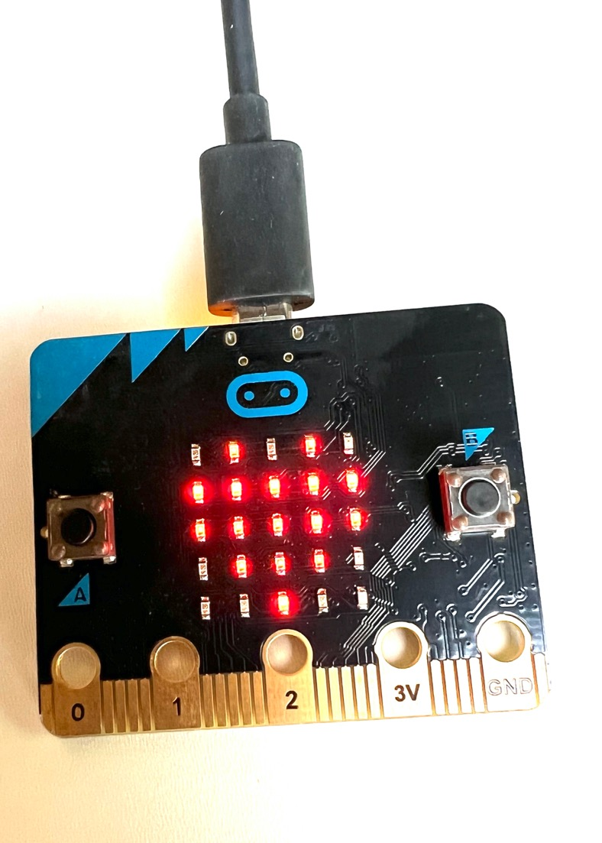
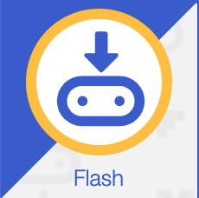
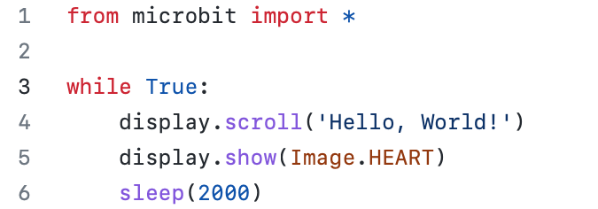
Flash code to the micro:bit
Program the micro:bit in microPython
The editor opens with the default code:
Flash to the micro:bit
Wait for the light to stop blinking…

Slide 8
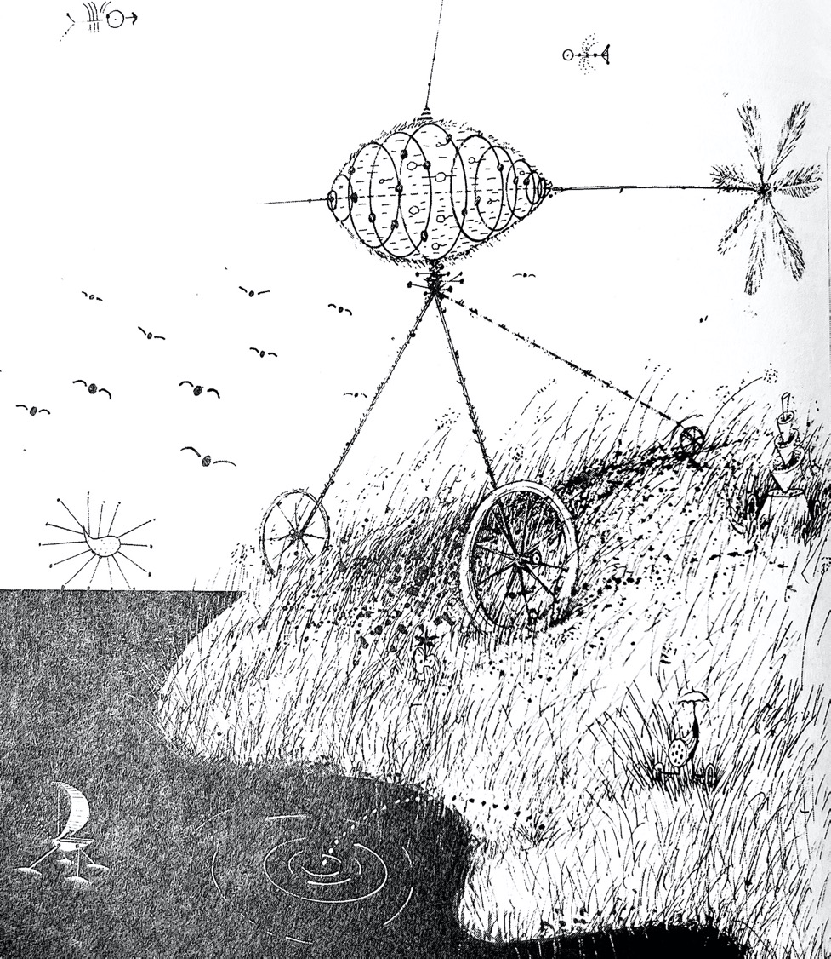
Vehicle 1: Getting Around
Vehicle 1 has one sensor and one motor.
The motor is anything that can provide a propulsive force, not just electric motors.
The sensor can be of any kind of analogue detector.

Slide 9
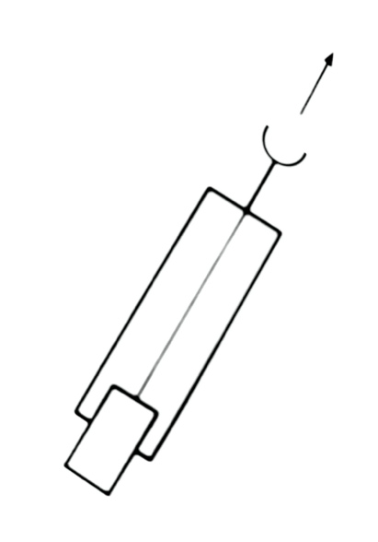
Vehicle 1
The signal is conveyed from the sensor to the motor by a nerve fibre, causing the motor to vary continuously in its output.
“The more there is of the quality to which the sensor is tuned, the faster the motor goes” - Braitenberg.

Slide 10
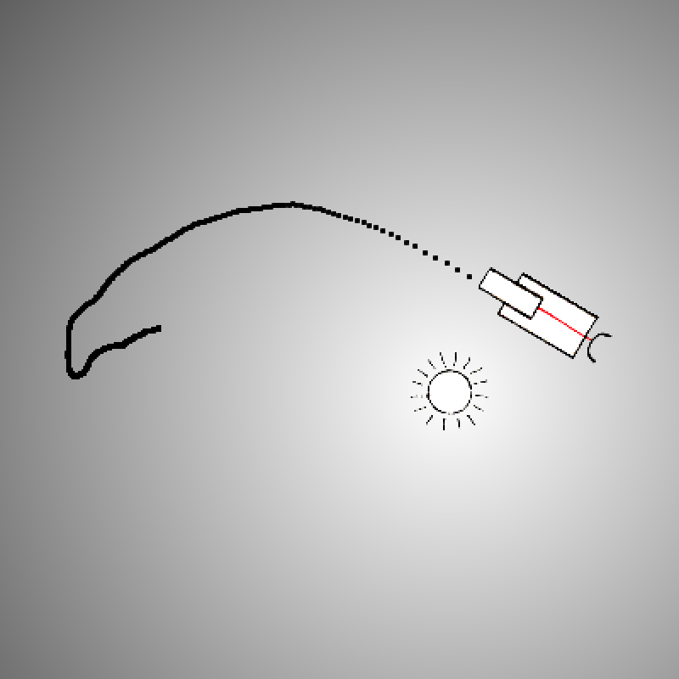
Vehicle 1 Simulator
Using a light sensor, the brighter the light, the faster it goes.
https://go.uwe.ac.uk/v1
Notes:
No steering.

Slide 11
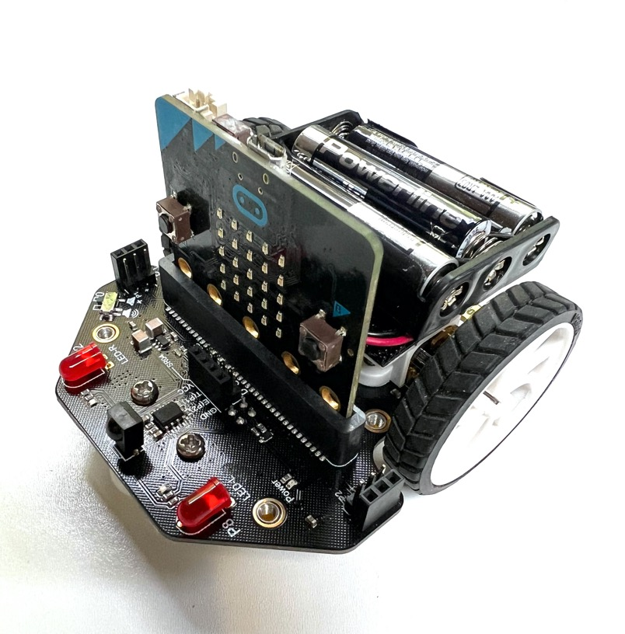
Maqueen robot
Plug the micro:bit into the robot.
Light Emitting Diodes (LEDs) can be used in reverse as a light sensor.
Get the vehicle.py code at: https://go.uwe.ac.uk/cybsoc1
Select the raw view, and copy all
Copy into the microPython editor

Slide 12
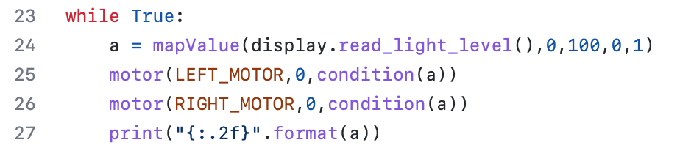
Vehicle1.py
Map sensor values from 0 (inactive) to 1 (active)
The sensor inputs positively excite the motor ‘neurons’
Condition the inputs into output range 0 – 225

Slide 13
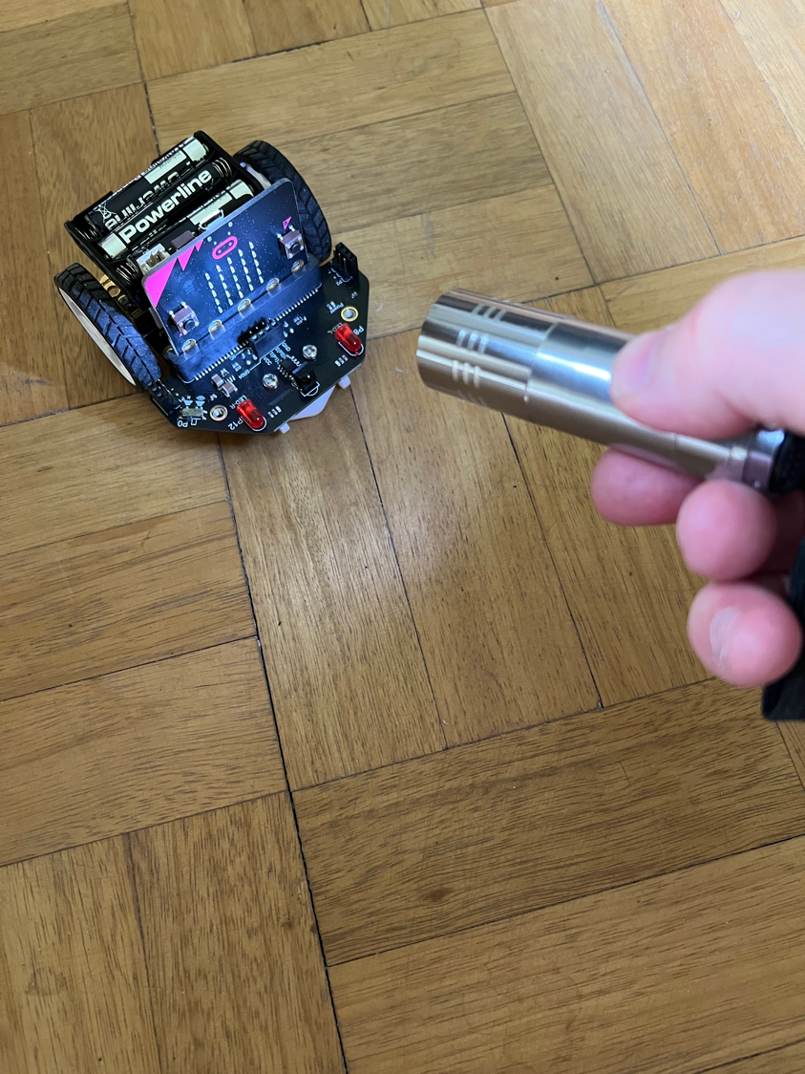

Open Serial connection
Flash the code to the robot
Switch the robot ON (switch at the back)
Open the serial connection to see the sensor values
Open the serial connection to see error messages
Can you use the torch to make the robot go?

Slide 14
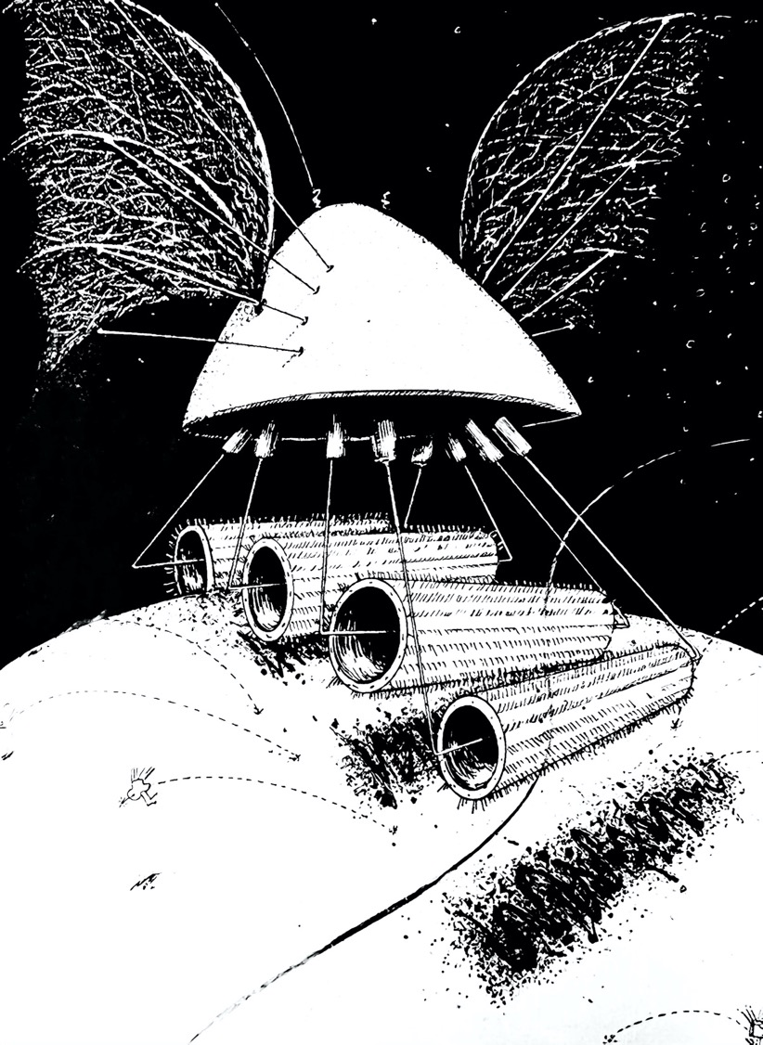
Vehicle 2: Fear & Aggression
Vehicle 2 equips our robot with a fight or flight response to light.
“It flees from light in fear, or heads towards it in a way that might be considered aggressive.” – Braitenberg
Notes:
Braitenberg teases us with these poetic purposeful descriptions.

Slide 15
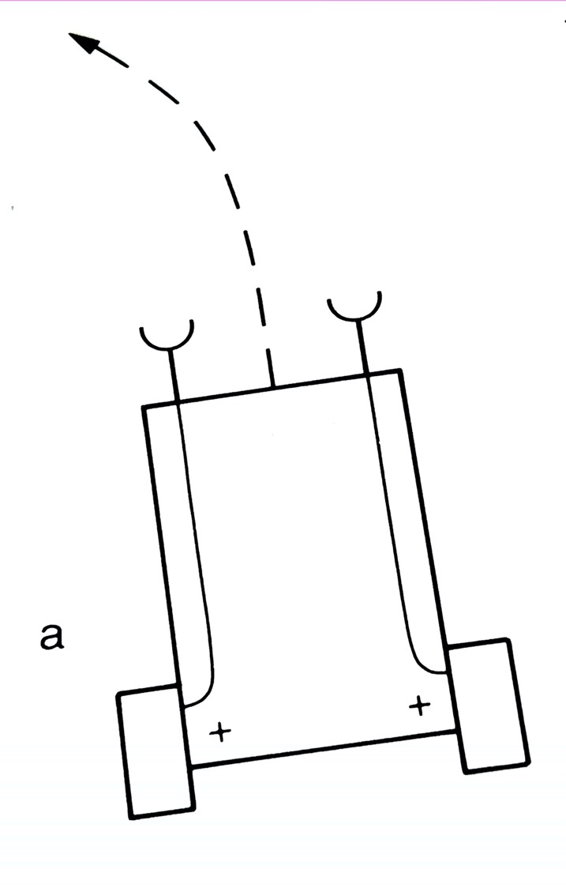

Vehicle 2a: Fear
Two eyes, and two motors.
'+' indicates an excitatory connection.
Vehicle 2a is averse to light, veering away from it, “escaping until it safely reaches a place where the influence of the source is scarcely felt. Vehicle 2a is a coward, you would say.” – Braitenberg

Slide 16
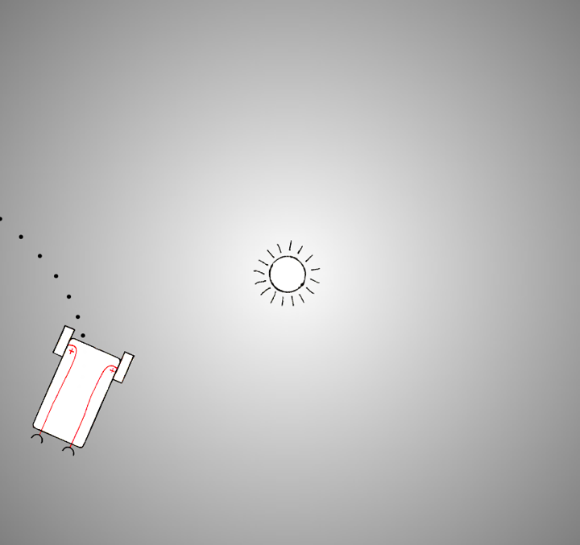
Vehicle 2a Simulator
Vehicle 2a connects each sensor to the motor on the same side.
If the light is brighter on one side of the vehicle, the motor on that side runs faster causing it to turn away from it.
https://go.uwe.ac.uk/v2

Slide 17
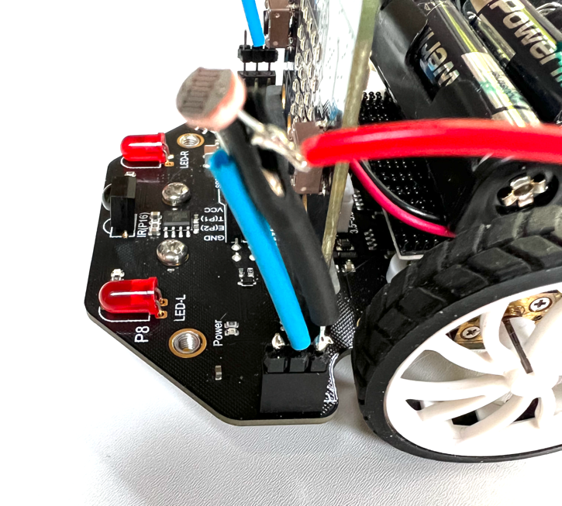
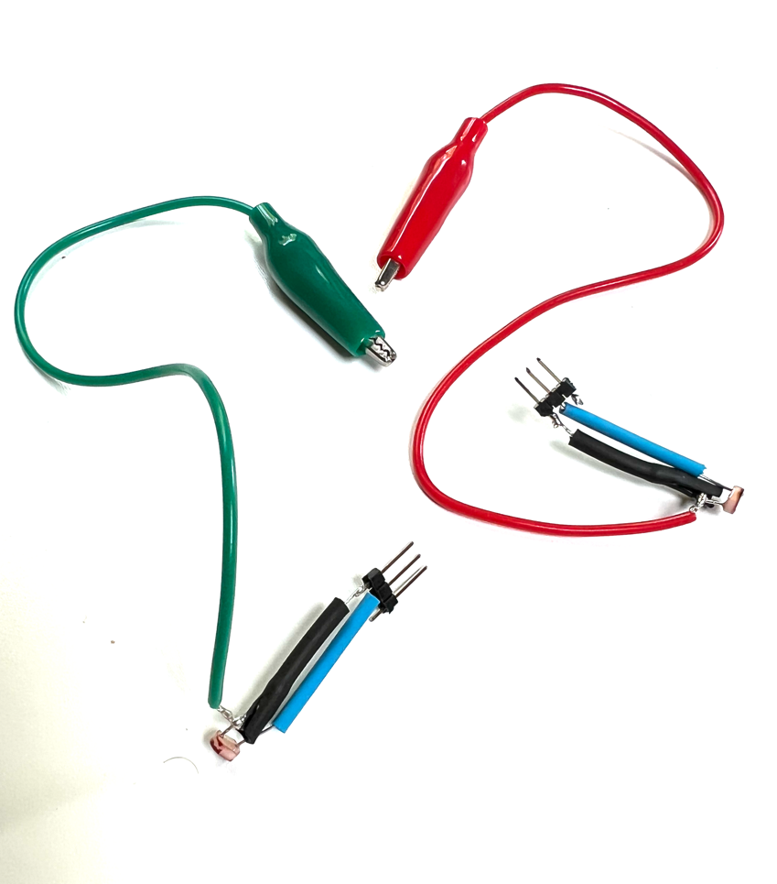
Photocells for Eyes
Grab a pair of photocell ‘eyes’
The colours don’t matter
Insert them into the sockets with the blue wire frontmost (but in the middle).

Slide 18
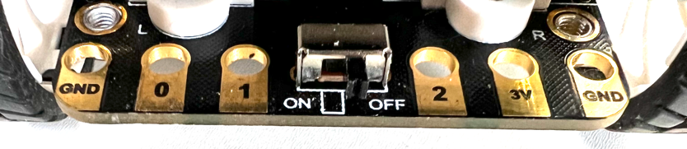
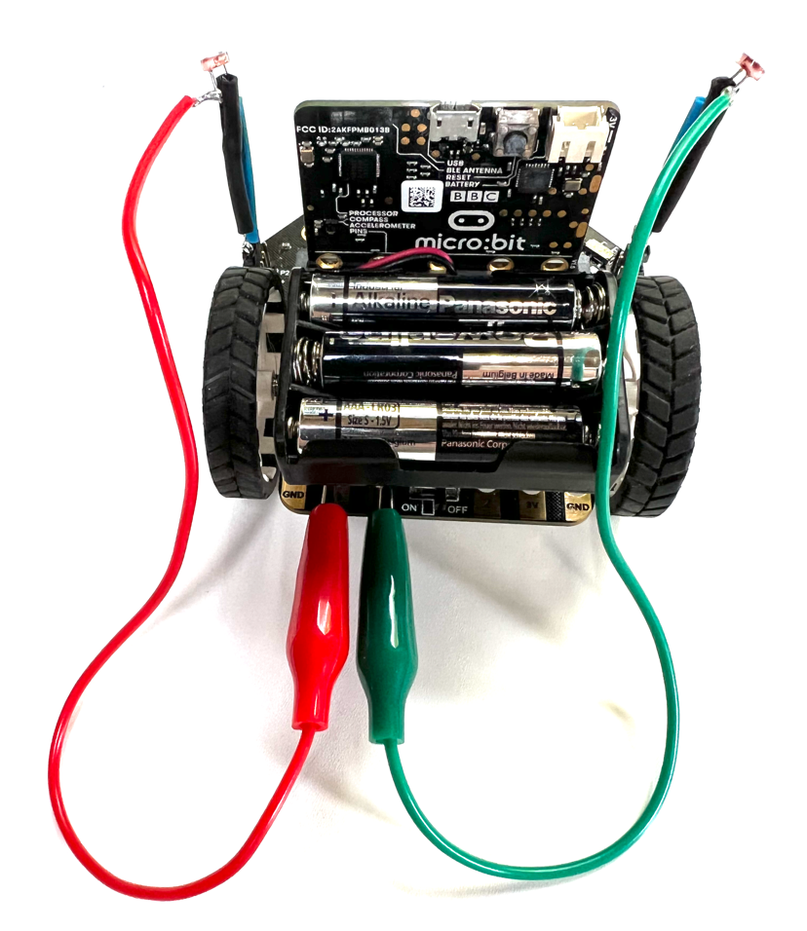
Wires for Brains
When light falls on the cell, its resistance drops and the signal is pulled high.
Connect the left eye to pin 0, and the right eye to pin 1 to control the left and right motors.
Get the vehicle2.py code from https://go.uwe.ac.uk/cybsoc1
Flash the code
Shade its eyes or use the torch to steer it

Slide 19
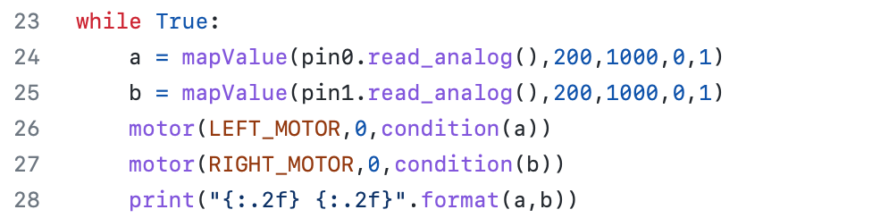
Vehicle2.py
Reads data from pin0 into variable a (mapped to 0-1)
Reads data from pin1 into variable b (mapped to 0-1)
Conditioned values a, b sent to left, right motors

Slide 20
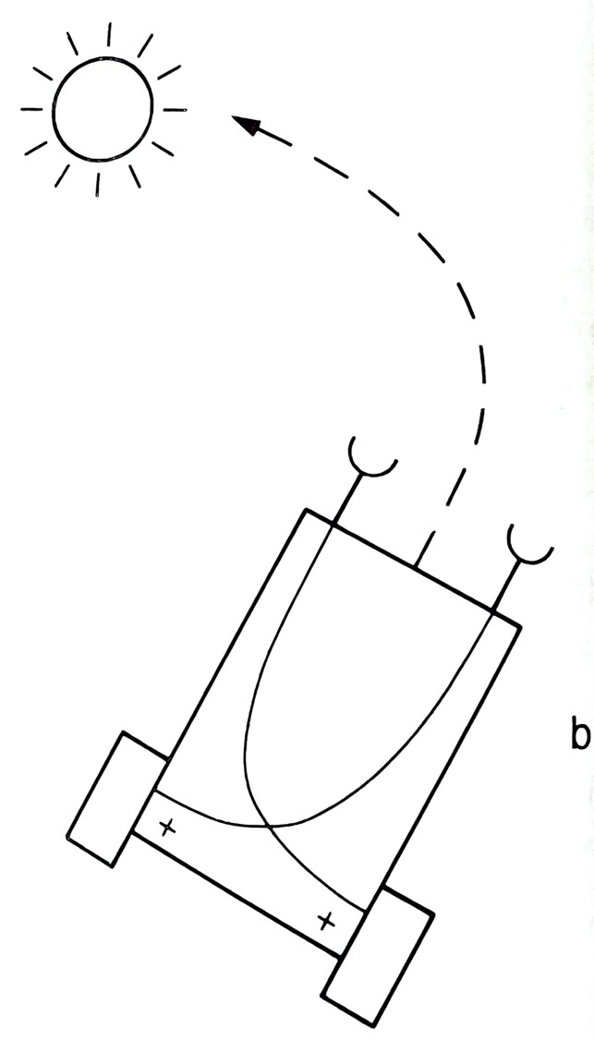
Vehicle 2b: Aggression
“Vehicle 2b. It, too, is excited by the presence of sources, but resolutely turns toward them and hits them with high velocity, as if it wanted to destroy them. Vehicle 2b is aggressive, obviously.” – Braitenberg

Slide 21
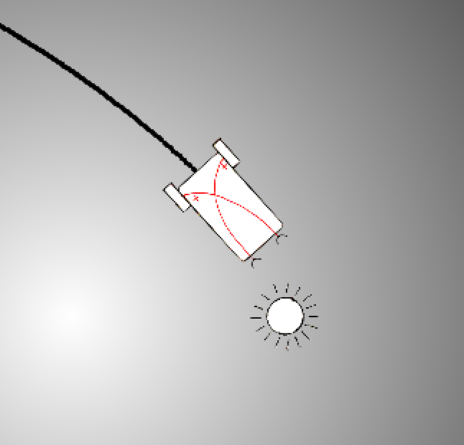
Vehicle 2b Simulator
Vehicle 2b connects each sensor to the motor on the opposite side.
If the light is brighter on one side of the vehicle, the motor on that side runs faster causing it to head towards the light.
https://go.uwe.ac.uk/v2

Slide 22
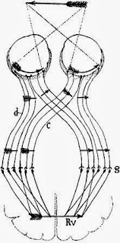
Crossing Connections
In 1899, Spanish neuroanatomist Ramón y Cajal observed optic nerve fibres from the half of the eye closest to the nose cross over to the opposite side of the brain.
Crossed connections are common in vertebrates, including us.
Nobody knows why.
Notes:
https://en.wikipedia.org/wiki/Santiago_Ramón_y_Cajal

Slide 23
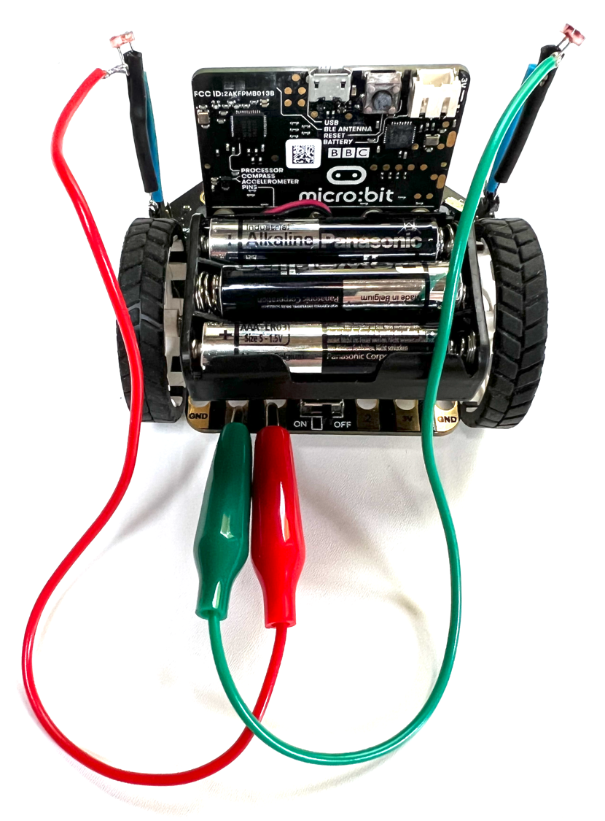
Vehicle 2b
No need to change the code
Just cross the connections to pin0 and pin1
Can you guide it with the torch?

Slide 24
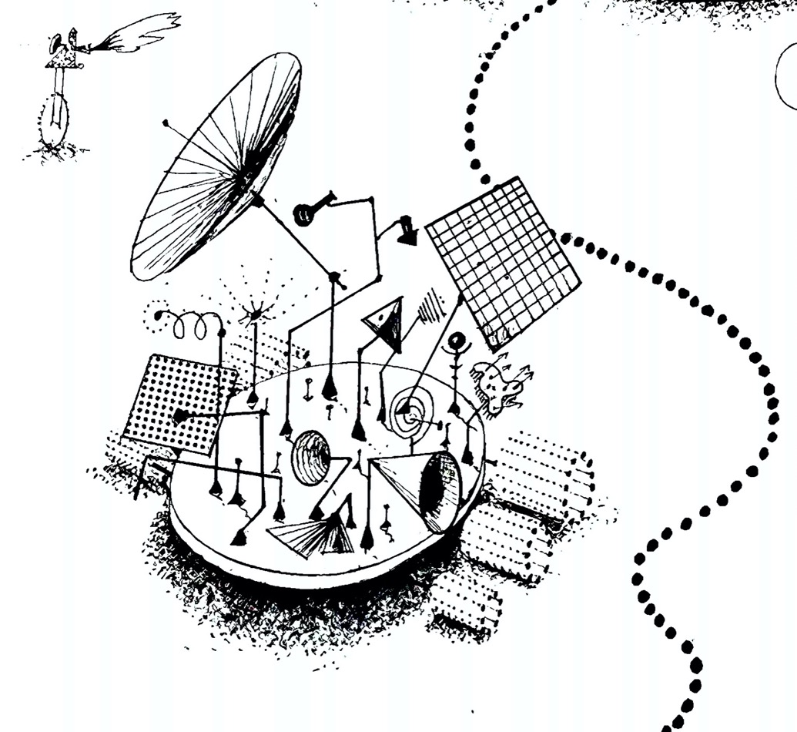
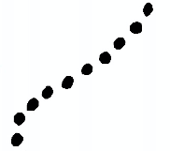
Vehicle 3: Love
Some sensors inhibit the motors, causing Vehicle 3 to slow down and bask in the sunshine that it loves.
“If you consider the possibility of strong and weak influences from the sensors to the motors, you realize that the variety becomes even greater.” – Braitenberg

Slide 25
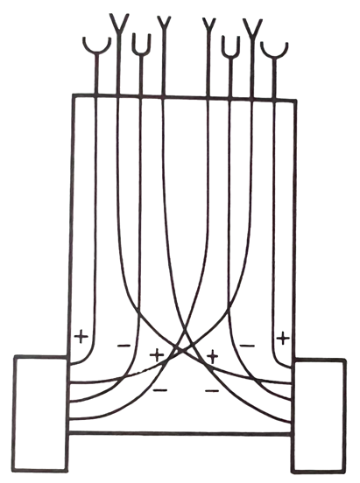
Vehicle 3
Multi-sensorial
'-' indicates an inhibitory connection.
Inputs arriving at the same time are summed together.
Bernard Katz observed the summation of signals in nerve cells in the 1950s in the squid giant synapse (not the same thing as a giant squid synapse).

Slide 26
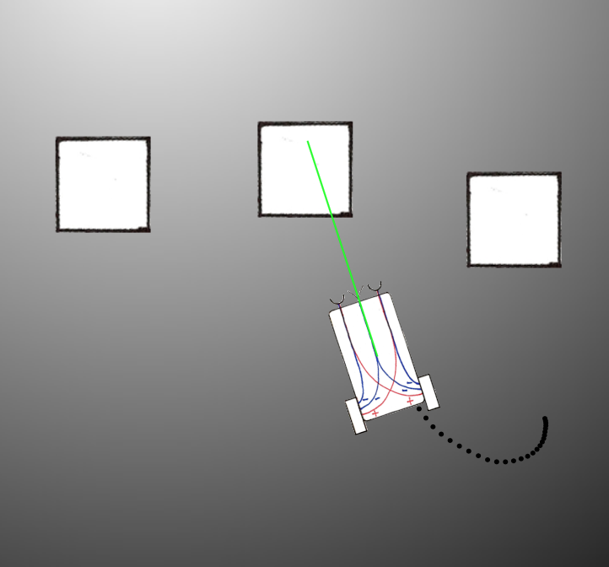
Vehicle 3 Simulator
A new proximity sensor inhibits the motors, causing Vehicle 3 to slow down.
https://go.uwe.ac.uk/v3

Slide 27
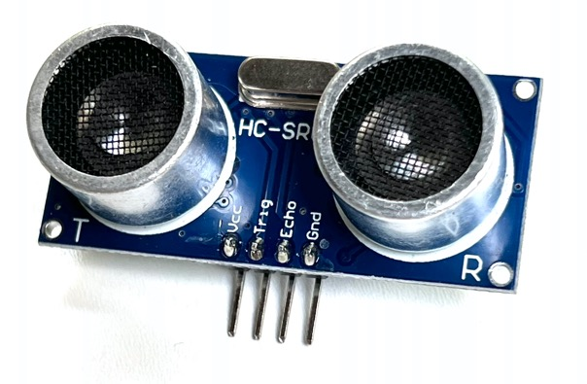
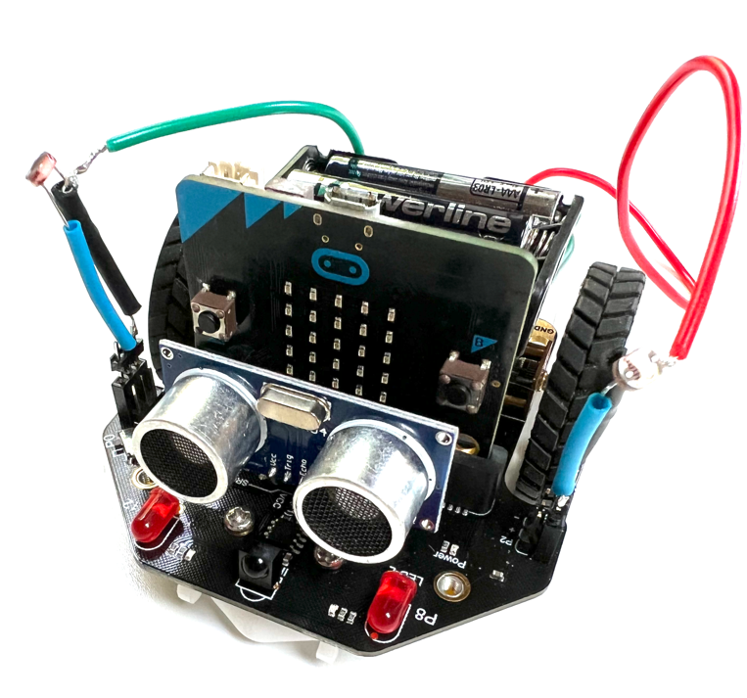
Ultrasonic Proximity Sensor
Grab an ultrasonic proximity sensor.
Plug it into the 4-way socket near the front of the robot.
Get the vehicle3.py code from https://go.uwe.ac.uk/cybsoc1
It transmits a 10us pulse and times the echo received.
Flash the code to the robot.

Slide 28
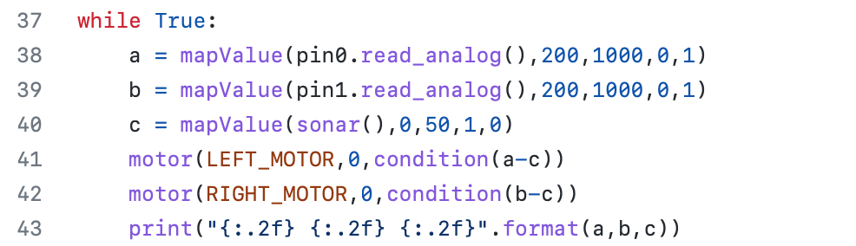
Vehicle3.py
New sensor data is read into variable c
This is subtracted from both motors (inhibitory)

Slide 29
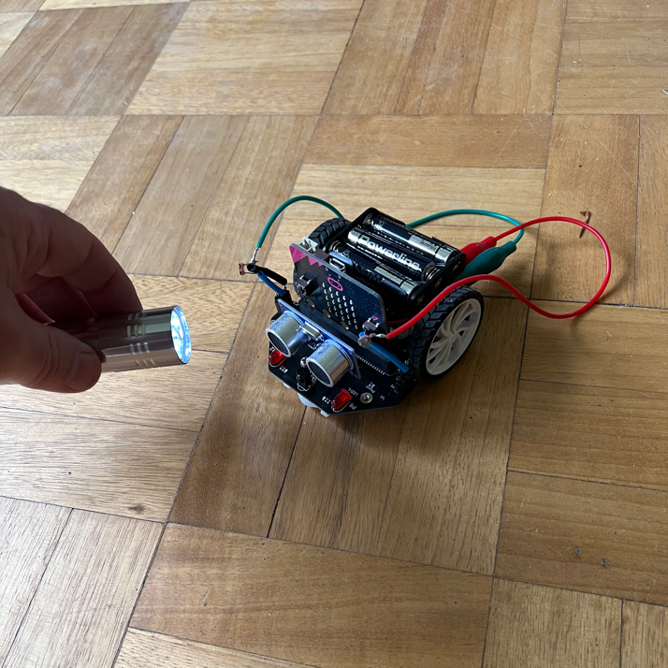
Purposeful behaviour
Vehicle 3 is now positively phototactic
The bat-like sonar gives it obstacle avoidance behaviour.
We can see vehicles as purposeful

Slide 30
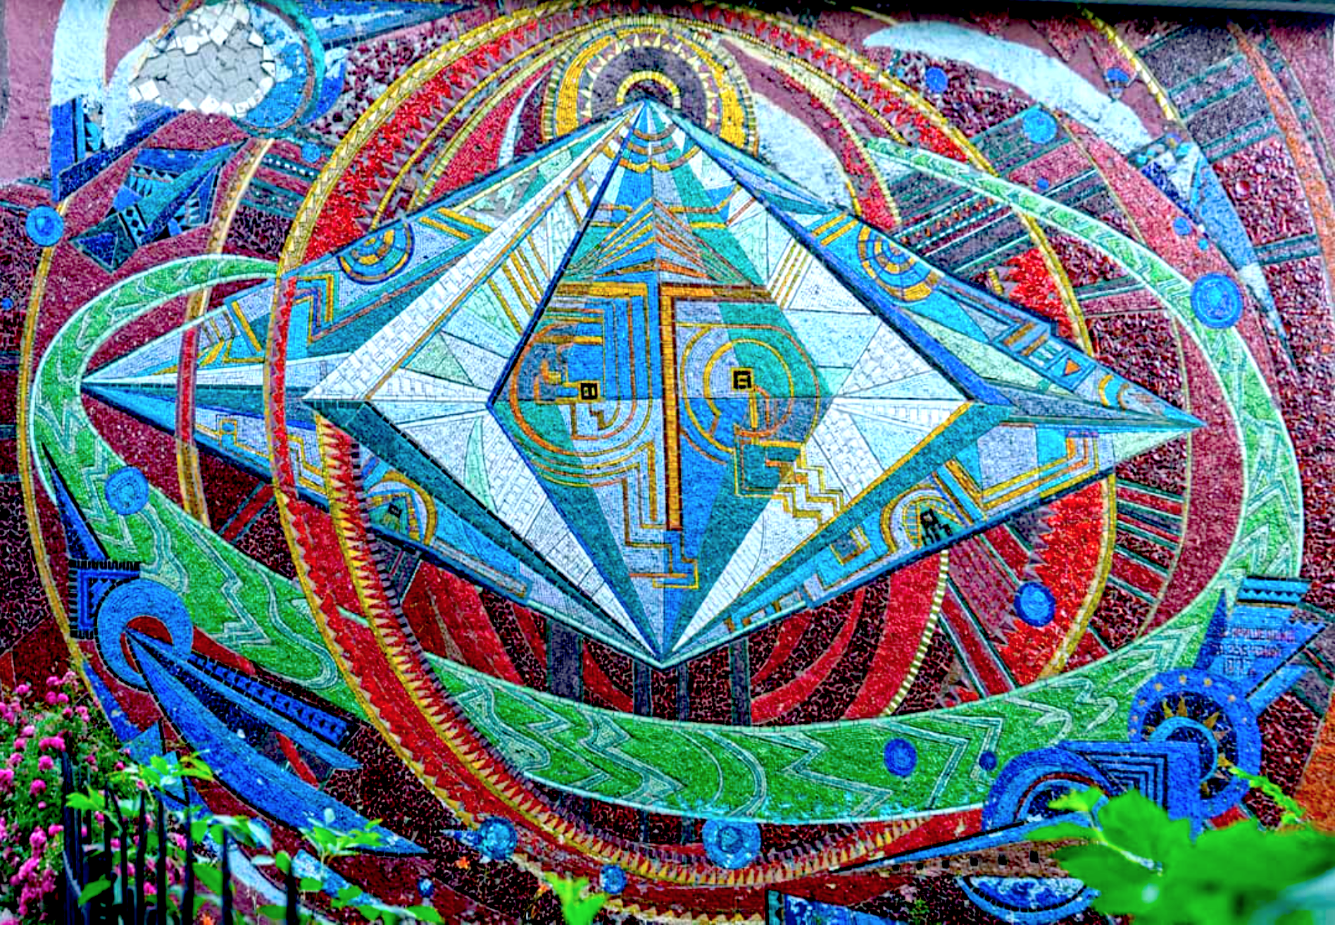
“The Triumph of Cybernetics”, Glushkov Institute of Cybernetics, Kyiv

